Slide 1
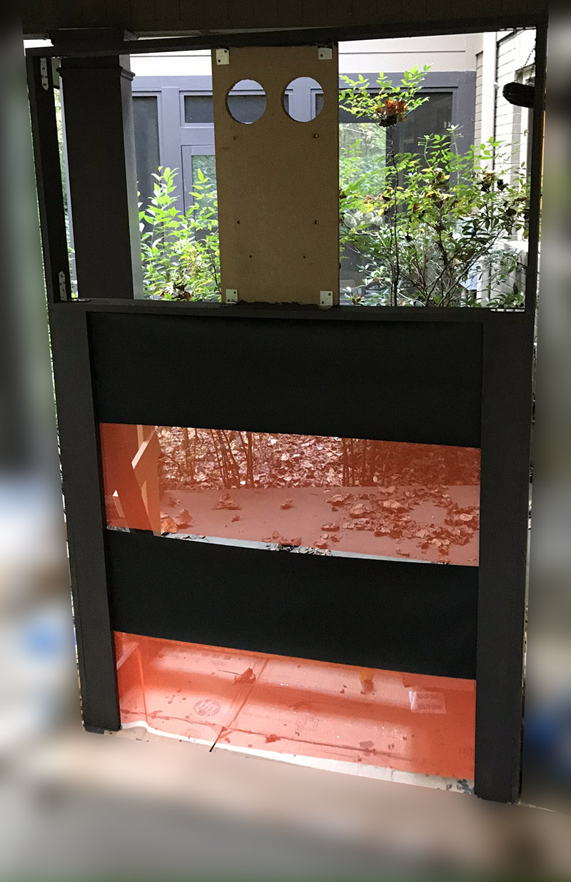
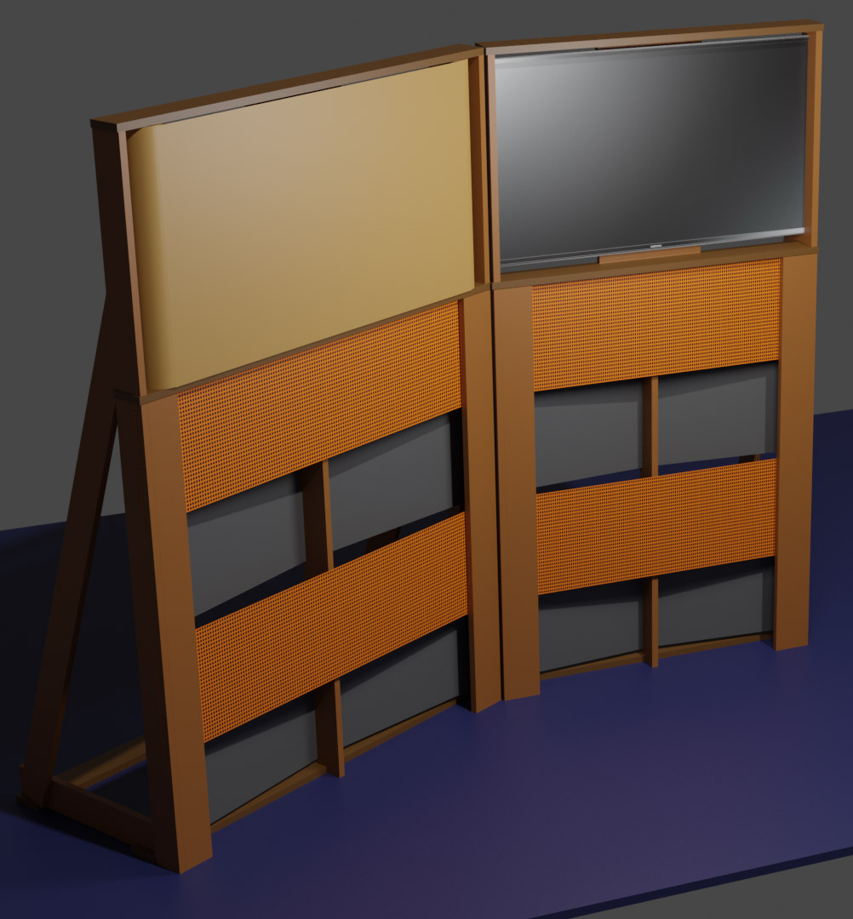
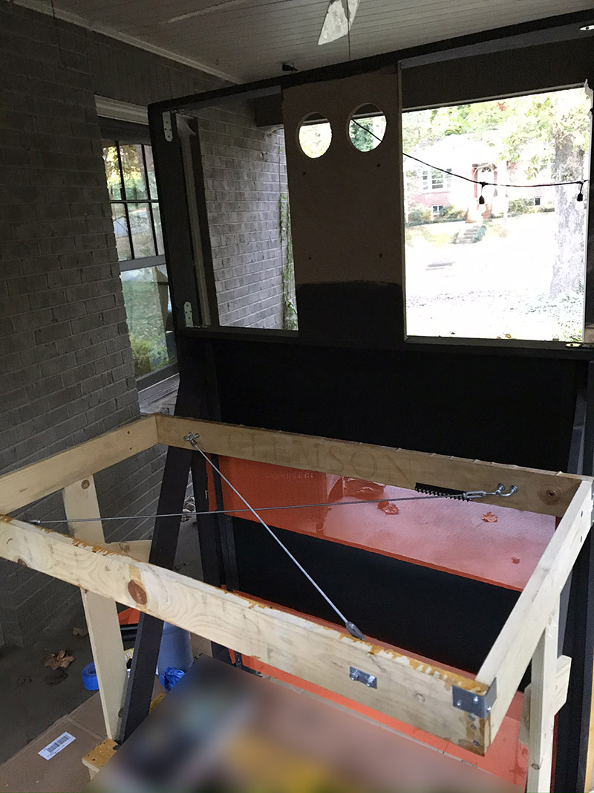

Slide 2
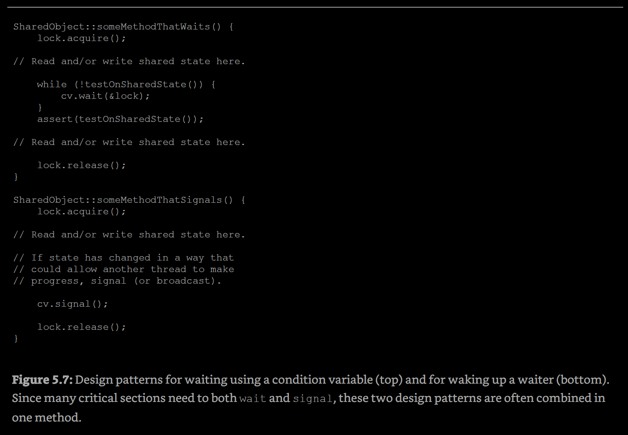
PR2 hints
The signal should be in release, not allocate.

Slide 3
Caching and Demand-Paged Virtual Memory

Slide 4
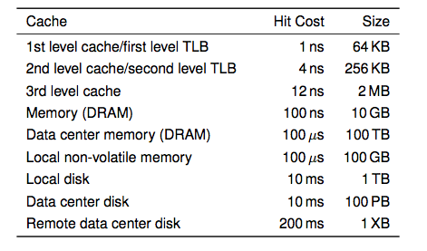
Memory Hierarchy
i7 has 8MB as shared 3rd level cache; 2nd level cache is per-core
Notes:
Anecdote: the system that I used for building my first OS, would fit in today’s 1st level cache

Slide 5
 | Hit cost
CPU register | “usually 1 CPU cycle”
L1 | 1.E-09
L2 | 4.E-09 | 4
L3 | 1.E-08 | 12
DRAM | 1.E-07 | 100
DC DRAM | 1.E-04 | 100,000
Flash | 1.E-04 | 100,000
Disk | 1.E-02 | 10,000,000
DC disk | 1.E-02 | 10,000,000
RDC disk | 2.E-01 | 200,000,000
Tape silo | 300 | 300,000,000,000
Station wagon or Snowmobile from ATL | 7200 | 7,200,000,000,000
Salt mine | (more) | (more)
20Y @1Gbps

Slide 6
Cache examples
Internet naming (re Young presentation: see also DNS attack)
Web content (local device)
Web search (search engine)
Email clients
Incremental compilation (e.g., make; W10:~16h/farm)
Just in time translation (e.g., Java, Android)
Virtual memory
File systems
Conditional branch prediction
Conceptual takeaways

Slide 7
Definitions
Cache
Copy of data that is faster to access than the original
Hit: if cache has copy
Miss: if cache does not have copy
Cache block
Unit of cache storage (multiple memory locations)
Temporal locality
Programs tend to reference the same memory locations multiple times
Example: instructions in a loop
Spatial locality
Programs tend to reference nearby locations
Example: data in a loop
tendencies -> predictives…

Slide 8
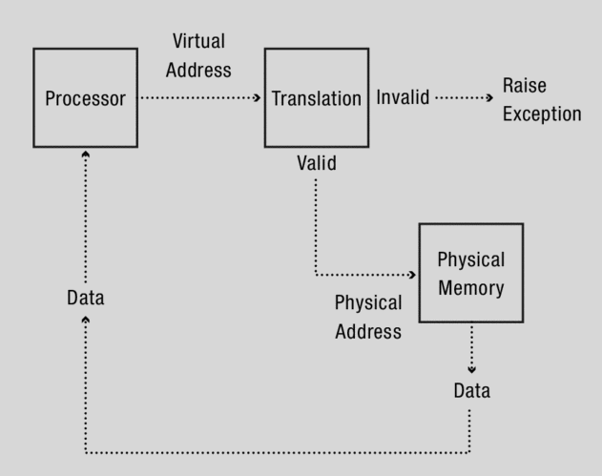
ch8.1, fig 8.1: Address translation in the abstract. The translator converts (virtual) memory addresses generated by the program into physical memory addresses

Slide 9
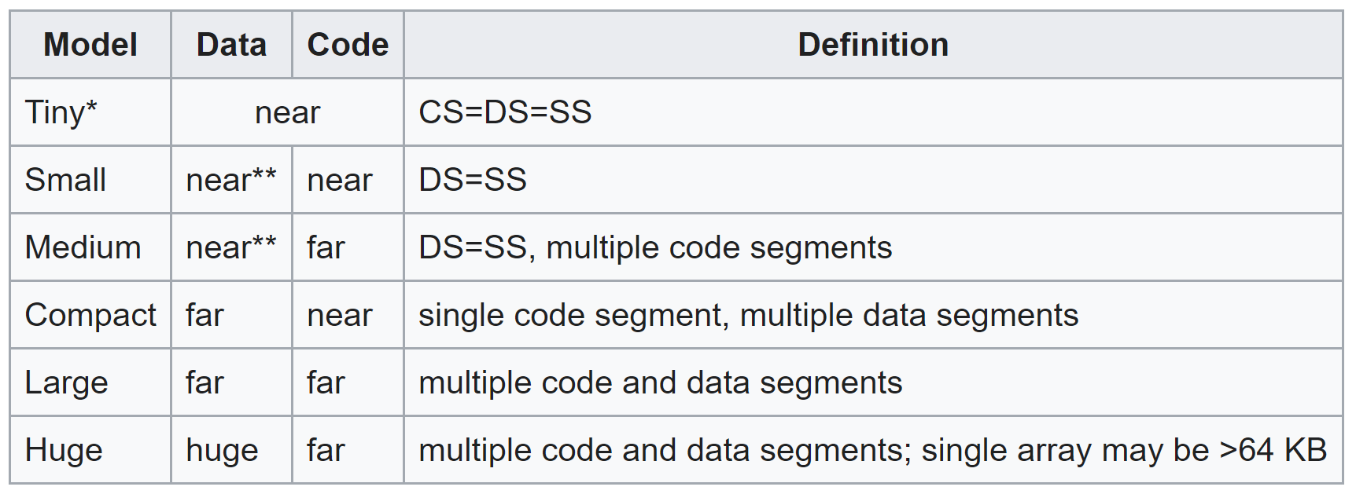
Physical memory addressing strategies
Segmented memory
However we place new segments, as more memory becomes allocated, OS may reach a point where there enough free space for a new segment, but free space is not contiguous.
Paged memory
memory allocated in fixed-sized chunks called page frames
Address translation similar to segmentation
Allows demand-based or anticipative insertion to main memory (best fit, worst fit, etc.); offloading to backing secondary store (relatively similar to caching)
X86; n=16bit,
f=32bit

Slide 10
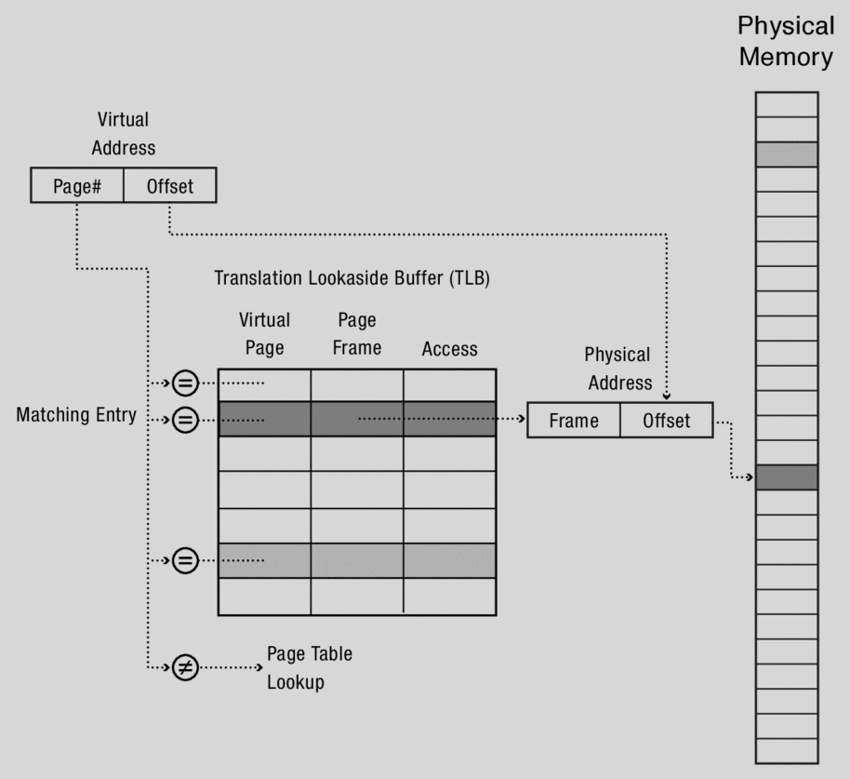
ch8.3.1, fig 8.10: Operation of a Translation Lookaside Buffer
each virtual page number checked against all of the entries in the TLB at same time
if match, the matching table entry contains the physical page frame and permissions.
If not, the hardware multi-level page table lookup is invoked

Slide 11
Main Points
Can we provide illusion of near infinite memory in limited physical memory?
Demand-paged virtual memory
Memory-mapped files
How do we choose which page to replace?
FIFO, MIN, LRU, LFU, Clock
What types of workloads does caching work for, and how well?
Spatial/temporal locality, …

Slide 12
Cache Replacement Policy
On a cache miss, how do we choose which entry to replace?
One possible assumption: new entry is more likely to be used in the near future
Policy goal: reduce cache misses
Improve expected case performance
Also: reduce likelihood of very poor performance

Slide 13
A Simple Policy
Random?
Replace a random entry
FIFO?
Replace the entry that has been in the cache the longest time
What could go wrong?

Slide 14
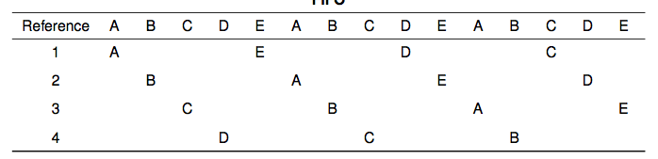
FIFO in Action
Worst case for FIFO is if program strides through memory that is larger than the cache

Slide 15
MIN, LRU, LFU
MIN
Replace the cache entry that will not be used for the longest time into the future
limitations?
Least Recently Used (LRU)
Replace cache entry that has not been used for the longest time in the past
Approximation of MIN
Least Frequently Used (LFU)
Replace cache entry used the least often (in the recent past)

Slide 16
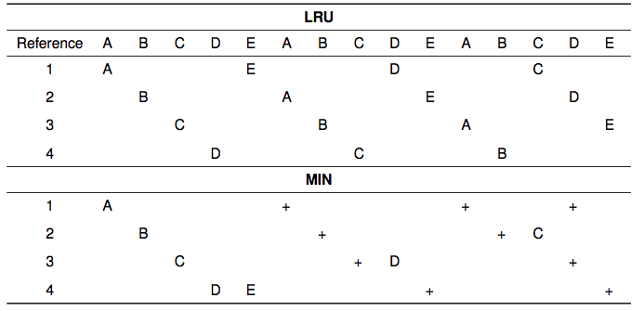
LRU/MIN for Sequential Scan

Slide 17
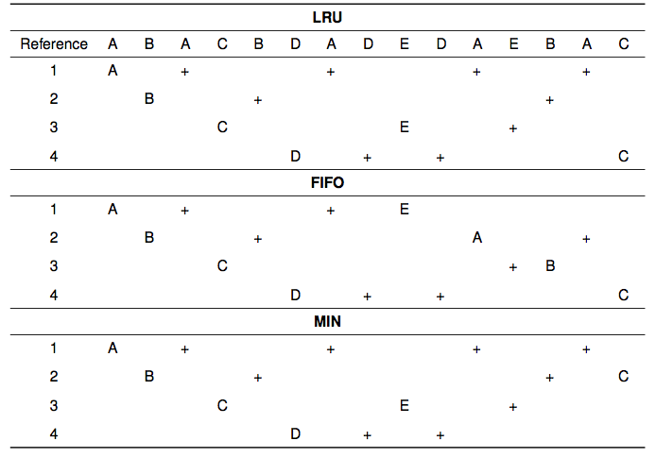
Notes:
For a reference pattern that exhibits locality

Slide 18
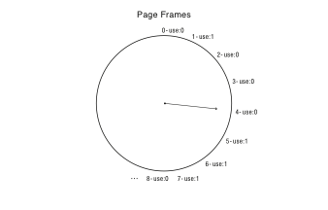
Clock Algorithm: Estimating LRU
Periodically, sweep through all pages
If page is unused, reclaim
Bin pages into sets of “not recently used”

Slide 19
Recap
MIN is optimal
replace the page or cache entry that will be used farthest into the future
LRU is an approximation of MIN
For programs that exhibit spatial and temporal locality
Clock/Nth Chance is an approximation of LRU
Bin pages into sets of “not recently used”

Slide 20
Virtual or Physical Dirty/Use Bits
Most machines keep dirty/use bits in the page table entry
Initialized to 0
HW sets bit automatically when store made w/in virtual page

Slide 21
Allocating a Page Frame
Select old page to evict
Find all page table entries that refer to old page
If page frame is shared
Set each page table entry to invalid
Remove any TLB entries
Copies of now invalid page table entry
Write changes on page back to disk, if necessary
Notes:
Why didn’t we need to shoot down the TLB before?

Slide 22
How do we know if page has been modified?
Every page table entry has some bookkeeping
Has page been modified?
Set by hardware on store instruction
In both TLB and page table entry
Has page been recently used?
Set by hardware on in page table entry on every TLB miss
Bookkeeping bits can be reset by the OS kernel
When changes to page are flushed to disk
To track whether page is recently used

Slide 23
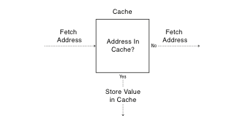
Cache Concept (Read)

Slide 24
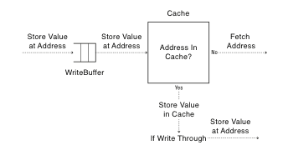
Cache Concept (Write)
Write through: changes sent
immediately to next level of storage
Write back: changes stored in cache until cache block is replaced

